Slide 1

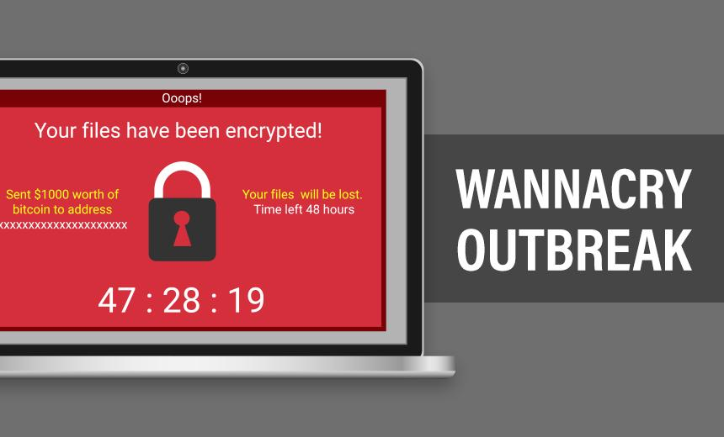
WannaCry Ransomware
By: Jasjot S. Benipal

Slide 2
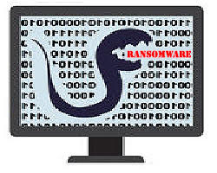
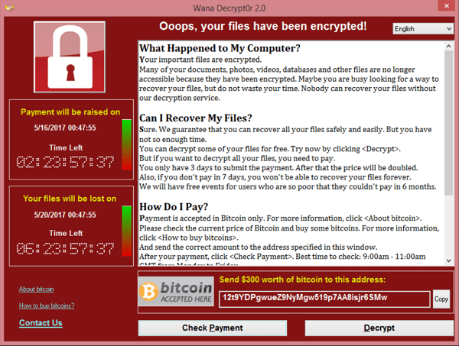
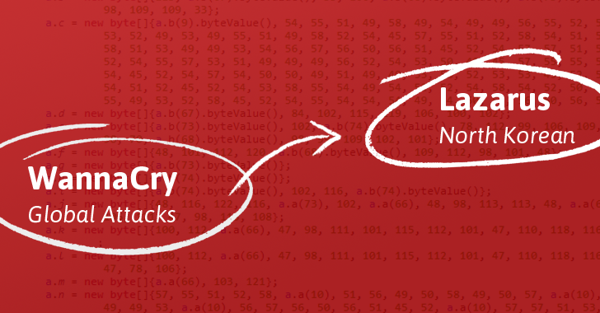
Overview
Wanna Cry was a ransomware worm that spread in May 2017.
Malware linked to the Lazarus Group.
Encrypts files on the PC's hard drive, then demands a ransom payment in bitcoin in order to decrypt them.
The WannaCry ransomware consisted of multiple different components.
Demanded $300 in Bitcoin to decrypt the files.

Slide 3
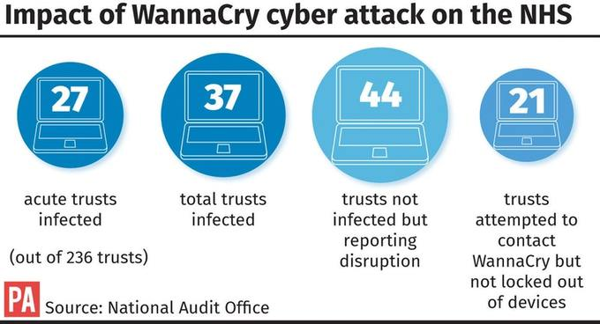
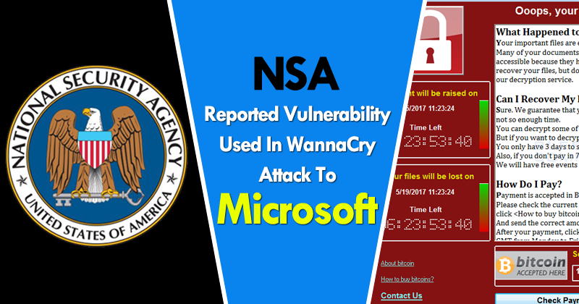
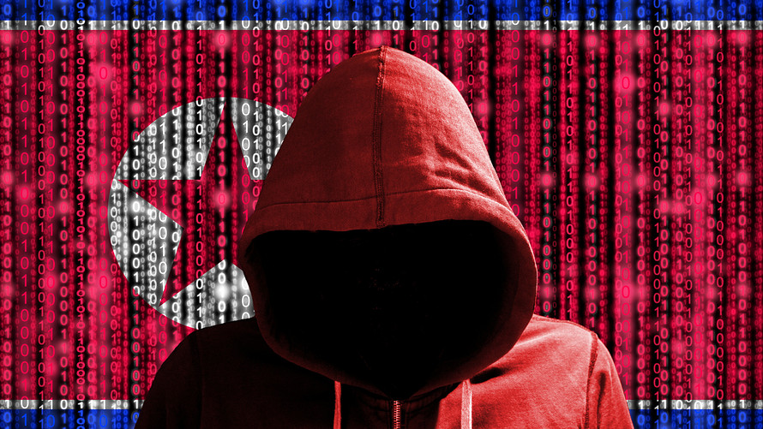
Some Interesting Facts
Initial spread of WannaCry was interesting.
Firstly, it struck important and high-profile systems.
Secondly, Windows vulnerability first discovered by the United States National Security Agency.
Lastly, cybercrime organization that may be connected to the North Korean government.

Slide 4
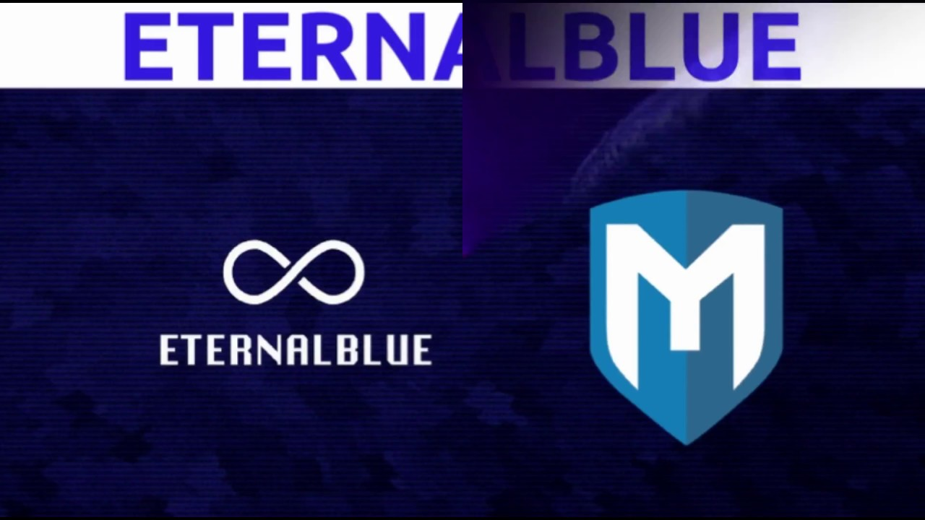
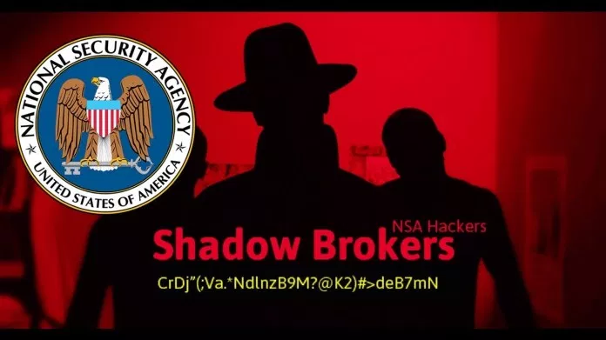
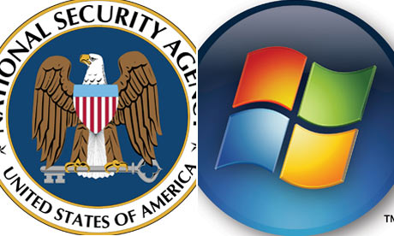
Its Targets
WannaCry exploit in the Windows implementation of the Server Message Block (SMB) protocol.
The U.S. National Security Agency (NSA) discovered this vulnerability and developed code called EternalBlue.
This exploit was in turn stolen by a hacking group known as the Shadow Brokers, who released it on April 8th, 2017.
It spread through an organization’s network or it could have affected individual users as well.
During the outbreak, Microsoft was really angry at the U.S. NSA for not reporting this exploit to them earlier.

Slide 5

What it Did
The program code was easy for security pros to analyze.
WannaCry tries to access a hard-coded URL, and if it can't, it proceeds to search for and encrypt files.
Files range from Microsoft Office files to MP3s and MKVs, leaving them inaccessible to the user.
Displays a ransom notice, demanding $300 in Bitcoin to decrypt the files.

Slide 6
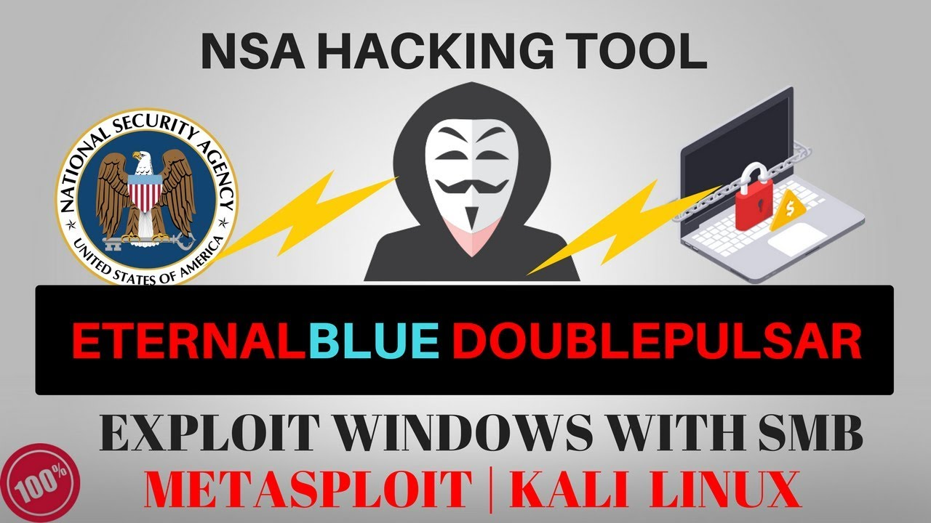
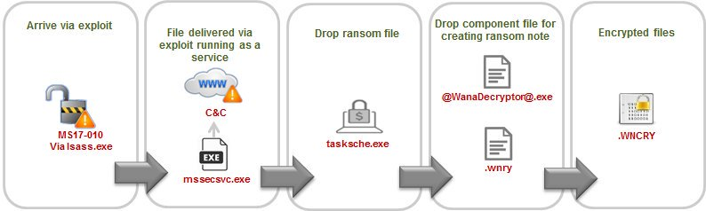
How it Worked
Initially arrived at the computer in the form of a dropper.
Components are an application that encrypts and decrypts data.
Files which contain encryption keys and a copy of Tor.
Tries to access a hard-coded URL but if it can’t do that, it encrypts files in order of important formats, leaving them inaccessible to the user.
WannaCry was spread by using the NSA-leaked EternalBlue exploit and also the NSA DoublePulsar exploit.

Slide 7
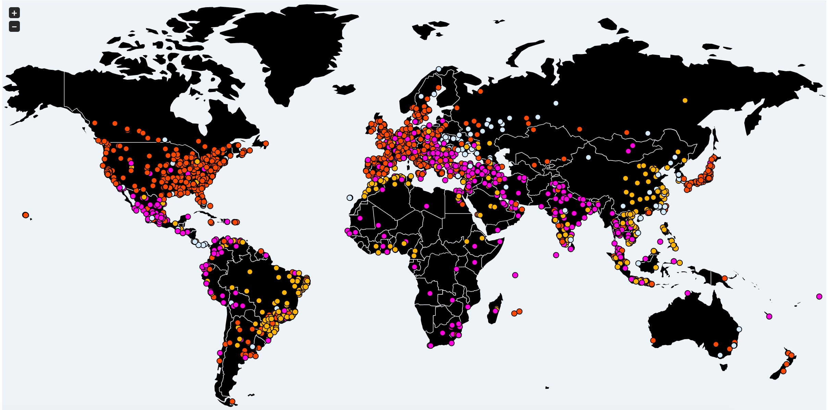


Its Effects
Estimates are that around 200,000 computers infected across 150 countries.
As of 14 June 2017, a total of 327 payments totalling $130,634.77 US dollars had been transferred.
One of the largest agencies struck by the attack was the National Health Service and up to 70,000 devices may have been affected.
The attack could have been much worse if Marcus Hutchins had not discovered that a kill-switch had been built in by its creator.
Economic losses from the cyber attack could reach up to US$4 billion, with other groups estimating the losses to be in the hundreds of millions.

Slide 8



Its Control
After the initial attack in May, Microsoft released emergency security patches for Windows 7 and Windows 8.1.
Organizations were advised to patch Windows in order to protect themselves from the cyber attack.
Researcher Marcus Hutchins accidentally discovered the kill switch domain hardcoded in the malware.
Researchers from University College London and Boston University reported that their PayBreak system could defeat WannaCry and other ransomware.
A French researcher developed a tool known as WannaKey and this approach was followed by a second tool known as Wanakiwi.

Slide 9

Thanks For Listening
By: Jasjot S. Benipal

